Slide 1

7. Enter the competition
Notes:
Teacher notes
In this session, students begin to create their online entry for the Google Science Fair.
Students will also look at how to structure their entry based on the steps they have already completed.
Students will learn about intellectual property and the importance of health and safety.
Depending on time and the resources available, you could help students to create a film or presentation for their entry.

Slide 2

1
2
3
4
5
6
Identify a problem
Generate ideas
Develop a solution
Design the test
Communicate the results
Draw conclusions
Enter the competition

Slide 3
Session 7: Outline
Introduction The entry form Health and safety and the rules Top tips: How to enter Top tips: Permissions Top tips: Referencing Top tips: Creating videos and presentations
05 06 25 30 33 35 36

Slide 4
Materials you’ll need
Your complete project Google Science Fair website

Slide 5
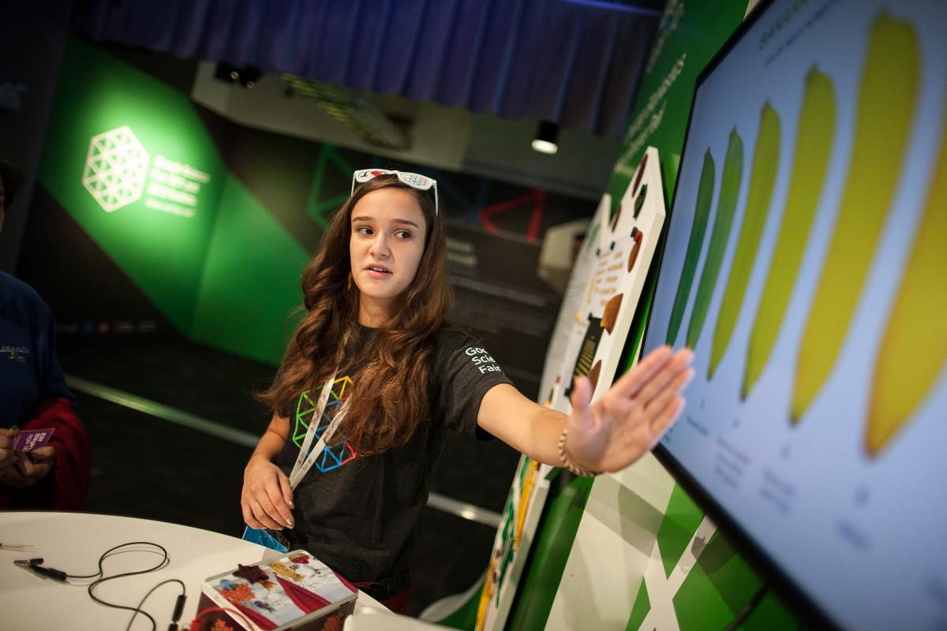
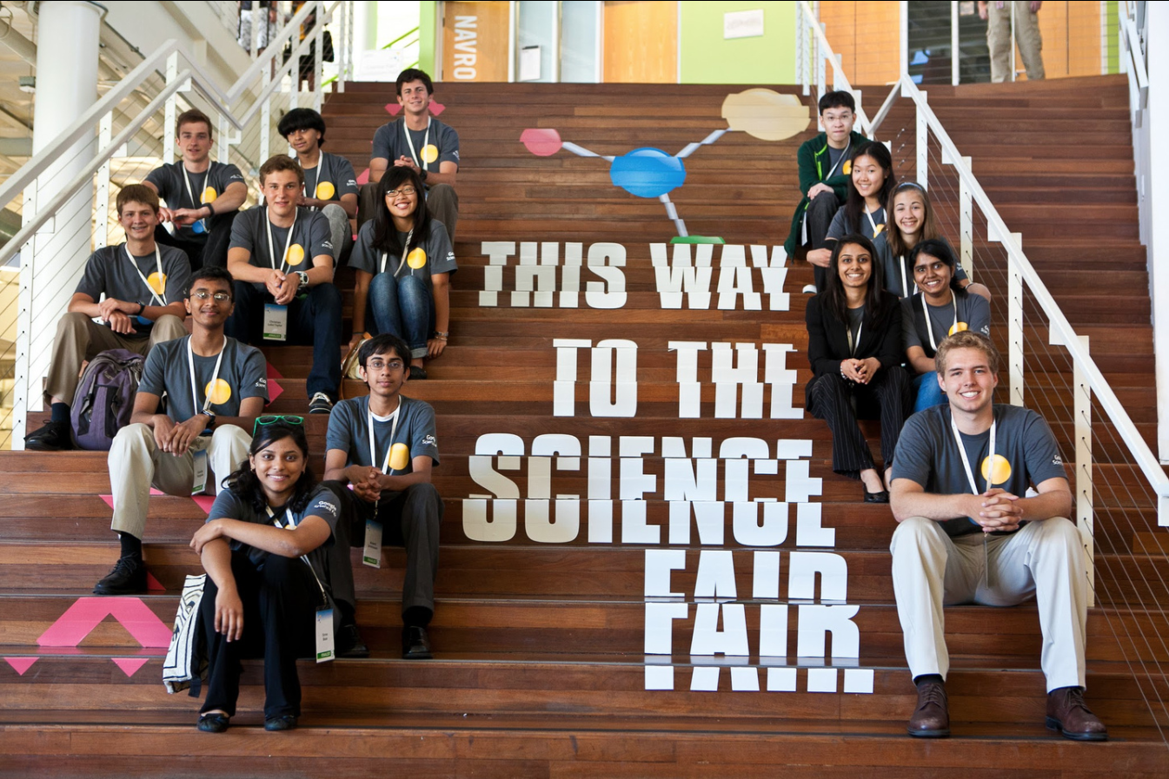
Notes:
Teacher notes
Remind students what the competition is.
Google Science Fair enables students to show innovative and creative problem solving projects on a global platform.
It enables 13 to 18 year-olds to have a platform for their ideas and take them further.
It also reinforces key skills which they already use every day - creativity, communication, problem-solving, scientific thinking — and they can get rewarded for it with fantastic prizes.
Open to all, globally. The competition has been running since 2011 and winners have come from over 100 countries.
It’s all about finding a problem to solve, thinking about how you might solve it, then presenting your solution.
Now that the students have completed their project, they need to create their entry.

Slide 6
The entry form

Slide 7

The entry form
The entry form has been set out in different sections to follow either the scientific or computational thinking/engineering method — but it’s all things you have already done!
Each section contains helpful links, so there is always some help should you get stuck.
Notes:
Teacher notes
Whether they are working in a team or by themselves, all students will need to sign up for their own account at www.googlesciencefair.com
They will need a Gmail account to sign up.
They will need to add their project to the entry form, which has been split by section.
They will additionally be asked for some information about themselves and a short overall summary of their project - this is where they can show their creativity in a short 2-minute film or 20-slide presentation.
Walk students through the entry process and ask them to complete each section based on their project details.
There is a word count on each section which should guide them - reinforce that this should help them think about communication. They can write beyond the word limit, but the judges are only required to read to that limit. They need to present their information clearly and concisely within each section.

Slide 8

The entry form
Summary About me/the team Question/proposal Research Method/testing & redesign Results Conclusion/report Bibliography, references & acknowledgements

Slide 9

The entry form
Summary
Your summary will probably be the first thing the judges look at. Be sure to include a clear and concise overview of your question or problem, the stages of your project, what you set out to achieve and whether you succeeded.

Slide 10
The entry form
Summary
What you could include:
why you chose to investigate this particular aspect of science or engineering
the question or problem that you investigated, and your hypothesis or predicted outcome
an overview of your research
the method or technique that you used in your experiment or testing
what you discovered
your conclusion; did the results of your experiment or testing support your hypothesis or predicted outcome?
how your findings will be helpful in the area you’ve explored
what you might do next
you can choose to include a 20-slide presentation or two-minute video.

Slide 11

The entry form
About me / the team
Present your ideas with passion and confidence. Don’t hold back. What would winning really mean to you? Share with us your love for science and engineering.

Slide 12

The entry form
About me / the team
What you could include:
where you live and what you love doing most
what originally got you interested science and engineering, and how this has influenced your life
the names of scientists or engineers that you admire and have been inspired by
what your future college or career plans are
what winning would mean to you, and how the prizes would change your life.

Slide 13
The entry form
Question / proposal
Your question or proposal should be interesting (especially to you), creative, scientifically worded, and relevant to today’s world.
You should include a hypothesis or expected outcome that’s tightly focused, follows naturally from the question, and builds on existing knowledge.

Slide 14

The entry form
Question / proposal
What you could include:
the primary question you’re investigating or the problem you’re trying to solve (make sure this is specific, measurable, scientifically worded and safe to investigate)
your hypothesis, or the outcome that you expect; what do you think will happen during your experiment or testing process, and how will your results show this?

Slide 15
The entry form
Research
Remember that good research validates a project. But great research goes a step further by demonstrating how the real world could benefit from the project.

Slide 16

The entry form
Research
What you could include:
a summary of the work others have already done in your chosen area
an explanation of how your research into this existing work has shaped your project.

Slide 17

The entry form
Method / testing & redesign
Show you’ve used good experimental techniques or testing processes. Also, describe your method clearly and in detail.

Slide 18

The entry form
Method / testing & redesign
What you could include:
a step-by-step description of your experiment or testing process
your variable and independent variables (if relevant)
a write-up on how you ensured that your experiment or testing process was fair
info about where the experiment took place and the equipment you used
a list of any safety measures that you took.

Slide 19

The entry form
Results
Accurately record and present relevant data, results or observations — and describe the patterns of trends they support.

Slide 20
The entry form
Results
What you could include:
a description of your most important results, such as data or observations
any patterns or trends you noticed
your key data - clearly laid out in a table, graph or chart.

Slide 21
The entry form
Conclusion / report
Your conclusion or report should explain how your experiment answers your original question or problem, and whether it supports your hypothesis.

Slide 22

The entry form
Conclusion / report
What you could include:
a summary of your results
an explanation of whether your findings support your hypothesis or expected outcome — and why
thoughts on any limitations in your results. Are they 100% reliable or could your method be improved somehow?
the kind of future impact your results might have and if further work is needed. Have your results inspired you to ask more questions?

Slide 23
The entry form
Bibliography, references & acknowledgements
It’s important to acknowledge the sources you’ve consulted and to be honest about any assistance you’ve received — whether it was tracking down equipment and materials, making sure your project was safe for everyone involved, or getting help with unfamiliar equipment. Whatever it was, cite your references in clear detail.

Slide 24

The entry form
Bibliography, references & acknowledgements
What you could include:
a list of all the books, journal articles and websites you’ve used in your research. Include the author of the work, its title and the date it was written (or the website’s name and address)
an acknowledgement of anyone that’s helped with your project (like a parent, teacher, professor or mentor), detailing what they did and what you did on your own
details of any facilities you were given access to (maybe a school or university lab) and any special equipment you used.

Slide 25
Health & safety

Slide 26

Health & safety
Health and safety is very important to us — and that goes for both people and animals. If you break the Official Rules, you will be disqualified.
Notes:
Teacher notes
If the experiment or test was conducted at school, explain that the school has health and safety guidelines that the students followed - even if they didn’t realize it.
Run through your school’s/organization’s health and safety guidelines with the class.
Explain that health and safety guidelines are in place to protect the students and everyone around them. They are used in all labs across the globe - whether it is in a school, university or corporation.
Explain that they will need to add these guidelines to their project to show to the judges that they have conducted a safe test.

Slide 27
Health & safety
You cannot use any chemicals unless you are working in a registered laboratory, research center or school laboratory. You must follow their safety guidelines and attach those to your project, along with the physical contact/location details of the lab and the manager of the lab.
If you think your project might involve the use of hazardous chemicals, you should not handle them yourself — your adult mentor (or lab supervisor) should do this. Please provide us with the contact details for your mentor/supervisor.

Slide 28

Health & safety
If you are using a chemical or substance that you think might require specific health and safety guidelines, please do your research, ask your adult mentor/supervisor for instructions, and follow any and all applicable guidelines. Please also attach any guidelines you are following, along with the contact details for your mentor/supervisor.

Slide 29
Top tips

Slide 30

Top tips
How to enter
The key with the entry form is how you communicate your project. Keep these top tips in mind:
Think about your audience You want to communicate your idea to everyone, not just another scientist. Think about how you are talking about your process. Explain it to your parents, friends and teachers first — do they understand it?
Notes:
Teacher notes
Reinforce that communication is key. Students need to be clear and concise for their audience.
Remind students that judges have thousands of entries to read - what will make theirs stand out?

Slide 31

Top tips
How to enter
Use pictures and films These are a great way to bring your project to life. A short film could show your your project in action, while a picture could show your experiment set up or final product. All of these are fantastic ways of communicating your project — but don’t forget that you can only use pictures and films that you have created.
Check that your data is correct Even if you didn’t find what you expected, your data and calculations need to be accurate.

Slide 32

Top tips
How to enter
Include evidence You have a word count in your entry form to communicate each area clearly and concisely, but if you have more evidence to back it up, signpost it clearly and add it to your project. For example, if you have large amounts of data, include it as an appendix. If you’ve created code, share it with us via a link to the repository.

Slide 33
Top tips
Permissions
Intellectual property Other people’s intellectual property: while you might have looked at images, films or music, you cannot add anything you did not create to your project, even if you have permission. You can add a link to them, but you cannot have them in your project. If you do, you will be disqualified.
Notes:
Teacher notes
By submitting their project, students will be sharing it publicly. That means that they need to think about what they can and can’t include.
Introduce intellectual property.
Explain that when a person or company creates something, e.g. a piece of music, it is their property, therefore it can’t be shared unless an agreement has been made for it to be used.
In Google Science Fair, even if they have sought permission, it is against the rules to include anything that they have not created themselves. They can still quote from a publication, discuss another idea or link out to a video, image or piece of music etc., but they cannot include it in their projects.
Explain that their project is their intellectual property - they have created it and they own the work.

Slide 34
Top tips
Permissions
Brand names and logos You can’t mention any brand names or include their logos. You can say, for example, that you used a computer program that enabled you to complete your project, but you can only name it in your bibliography.
Remember that if people took part in your project, for example if they completed a survey, you shouldn’t include any personal data in your project.
Notes:
Teacher notes
Note that they cannot add logos or brand names in their project. If they have used a certain type of programming software, they can discuss it, its capabilities and what they used it for, but they shouldn’t be adding the logo. They can add the brand name in the references section but not the main entry sections.
As the project owner, they also have responsibility for any data used in the project. Explain that personal details (e.g. anything that identifies a person/organization - name, address, image etc.) is not allowed in the project. Note that this is for all studies, not just Google Science Fair - it is best practice to keep data sources anonymous. This means if they have observed anyone, or conducted a survey, they can show the results/findings but they must make sure that the person/people involved are not identifiable.

Slide 35
Top tips
Referencing
Make sure quotes are clearly attributed (e.g. book title, author, year of publication, page reference).
Reference clearly. If you have lots of data to add of your own, add it as a linked document — just make sure you are very clear in your project what it is/what the judge will find.
If you don’t reference these things, it looks like you are claiming the words or work as your own. Plagiarism is against the rules, so you’ll be disqualified if you don’t reference properly.
Notes:
Teacher notes
Introduce the term ‘standing on the shoulders of giants’. This means that we don’t all start at the same place - we can use the knowledge of others before us. This refers to the research they have done - books, websites, journals, films etc. It is expected that all problem solvers refer to previous work.
Explain that this is why it is important to clearly reference all of their sources - it shows a path of learning.
Discuss plagiarism - students must be aware that they cannot claim other people’s work as their own, therefore they must reference previous studies, clearly show any quotes and distinguish their work from others.

Slide 36

Top tips
Creating videos & presentations
In your summary section, you can choose to add a two-minute film or 20-slide presentation. This is designed to give the reader a really quick overview of your entire project. It’s also a great opportunity to show your creativity!
We’ve had some great examples over the years. Check out Elif’s hand-drawn summary film or Alex’s squid-jet propulsion presentation. They both explain their project clearly and concisely.
Notes:
Teacher notes
Highlight again that communication is a key part of the Google Science Fair.
In addition to their project steps, the entry form has a summary section that enables them to discuss their project in a creative way.
They can just submit a written summary section, but they could also bring their project to life for the judges and readers with a two-minute film or 20-slide presentation.
They need to keep in mind the rules about intellectual property when creating this.
Look at some previous finalists to see how they presented their project summary.
Elfi’s video: https://www.youtube.com/watch?v=El3vc_j-lao&feature=youtu.be
Alex’s project: https://archive.googlesciencefair.com/en/projects/ahJzfnNjaWVuY2VmYWlyLTIwMTJyRAsSC1Byb2plY3RTaXRlIjNhaEp6Zm5OamFXVnVZMlZtWVdseUxUSXdNVEp5RUFzU0IxQnliMnBsWTNRWWg4S1RBZ3cM

Slide 37

Top tips
Creating videos & presentations
Here are some top tips for making your summary:
Identify your audience. Think about who might be watching this. Judges, teachers, other teens — is it clear enough to understand even if that person is not an expert in your project?
What’s your story? What are you trying to say? You have been on a journey through the problem-solving process — does everything flow?

Slide 38
Top tips
Creating videos & presentations
Speak clearly / don’t write too much. Busy slides can be overwhelming and if you talk too fast, elements of your project will get lost. List out a top line for each step of your project and form it into a story.
Make sure that you haven’t broken any of the rules. No music at all, and no images that don’t belong to you, including brand logos and names.
Don’t forget! While it’s a great idea to add a video or presentation, it’s not required. However, you must add a written summary section.

Slide 39

Now you’re a problem-solving pro. Time to enter!
Submissions open in September 2018

